Slide 1
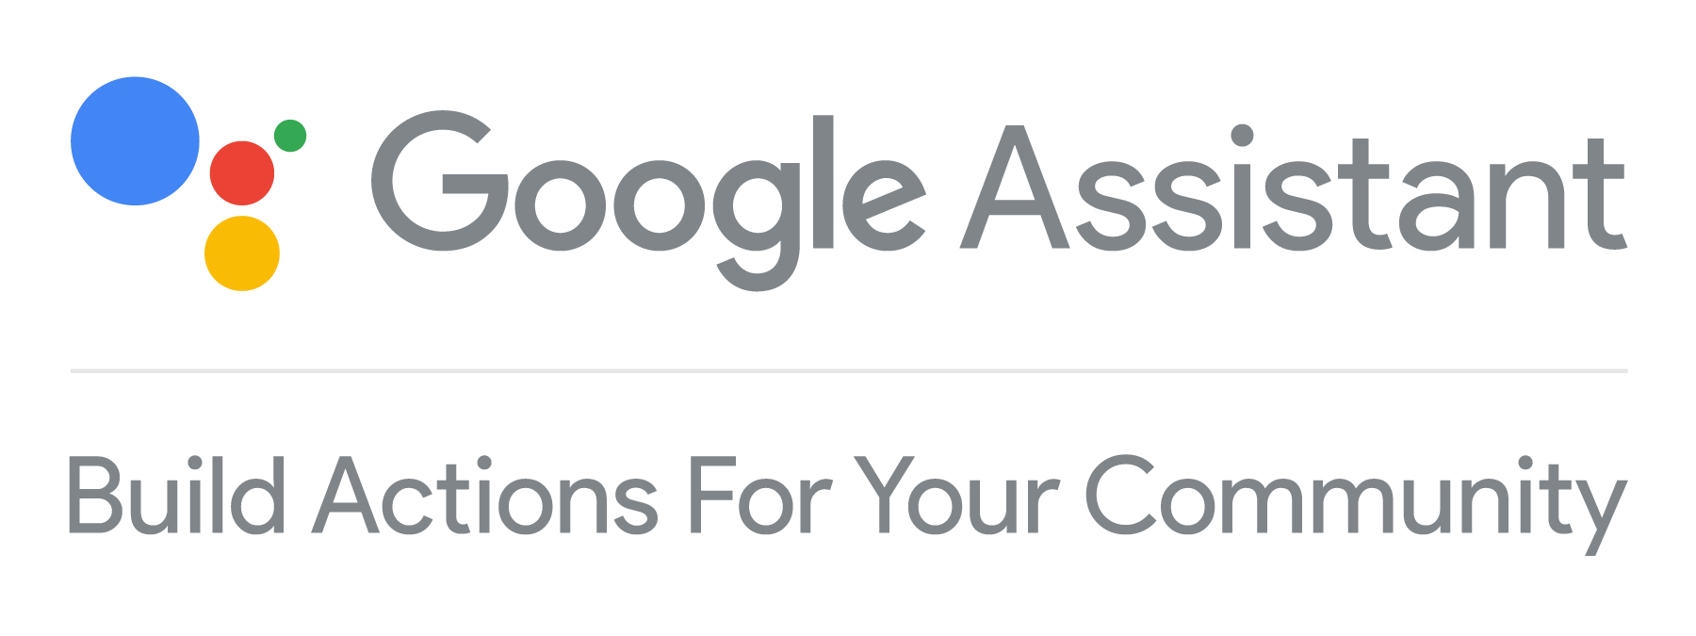
Devfest Cochin
Farha Abdul Kareem MEC
@farhakareem

Slide 2
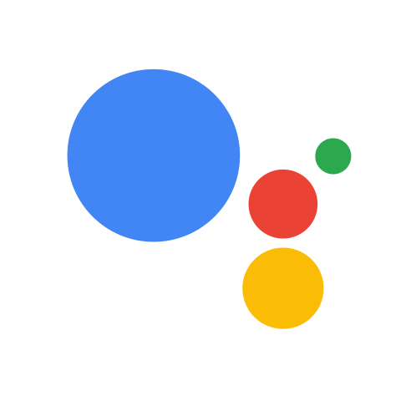

Install Telegram.
Join the Telegram Group - Search @devact
t.me/devact

Slide 3

Think of a use case that you are going to build.
Go wild.
Make it simple for now.
5 minutes to think :)

Slide 4
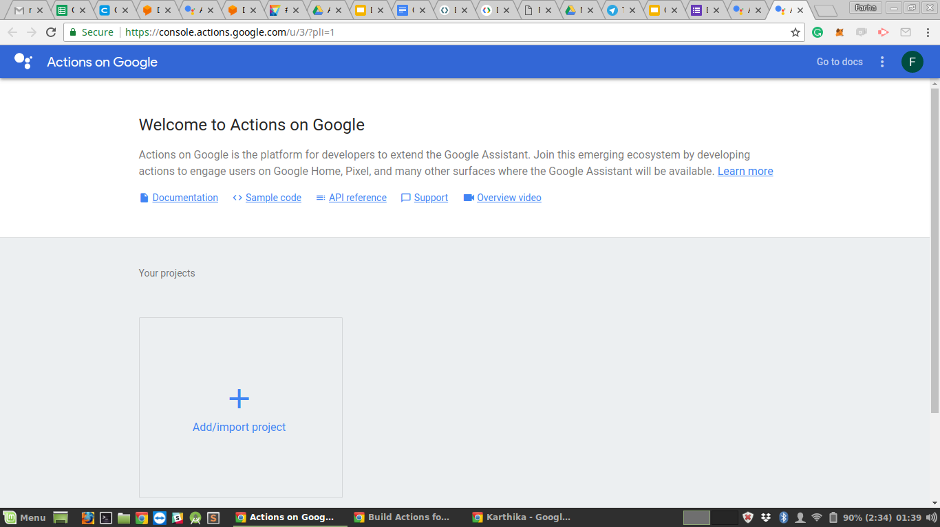
Go to Action on Google Console.

Slide 5
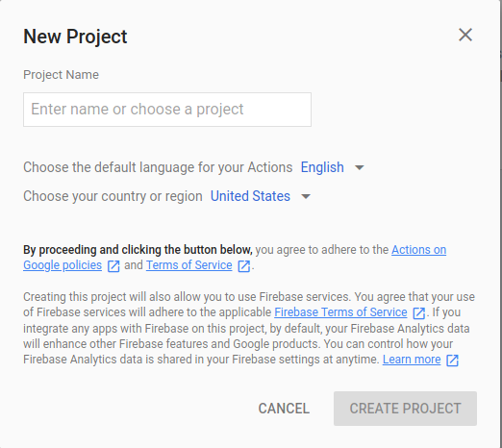
Type in your project name- for the use case you selected.
Create Project :)

Slide 6
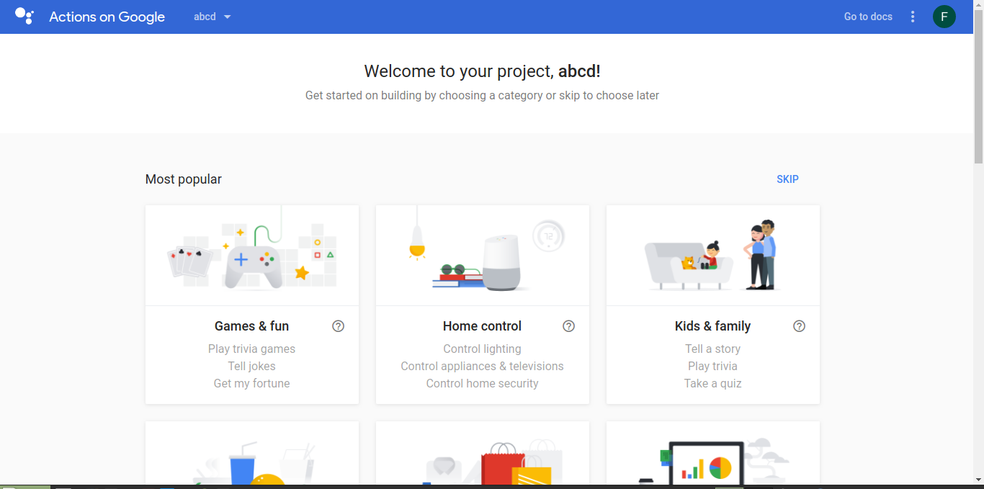
SKIP for now :)

Slide 7
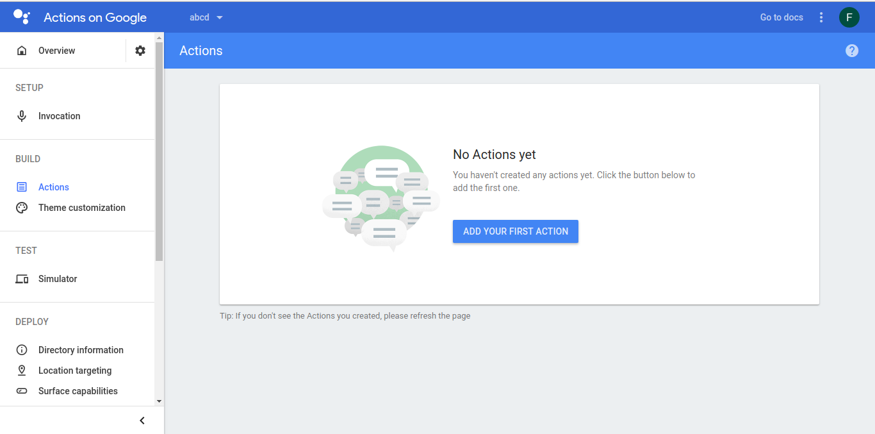
Build -> Actions -> Add your first Action.

Slide 8
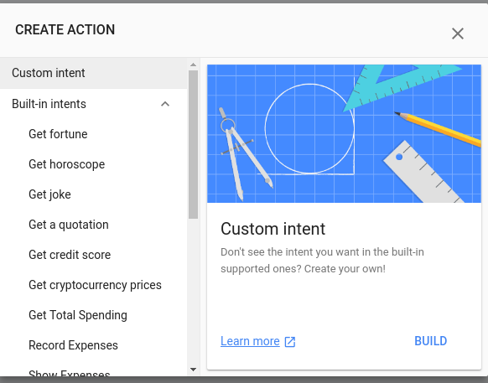
Custom Intent.
Build.

Slide 9

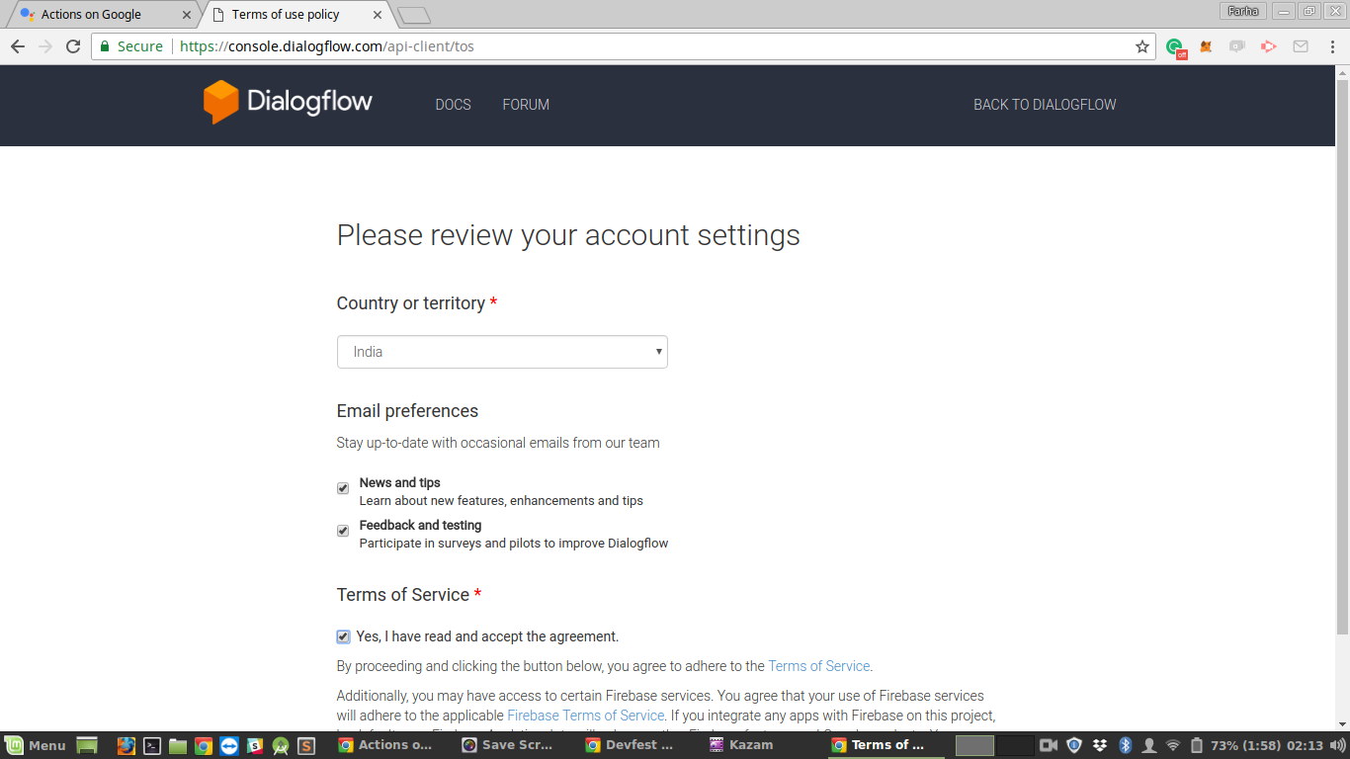
the most widely used tool to build Actions for more than 400M+ Google Assistant devices.

Slide 10
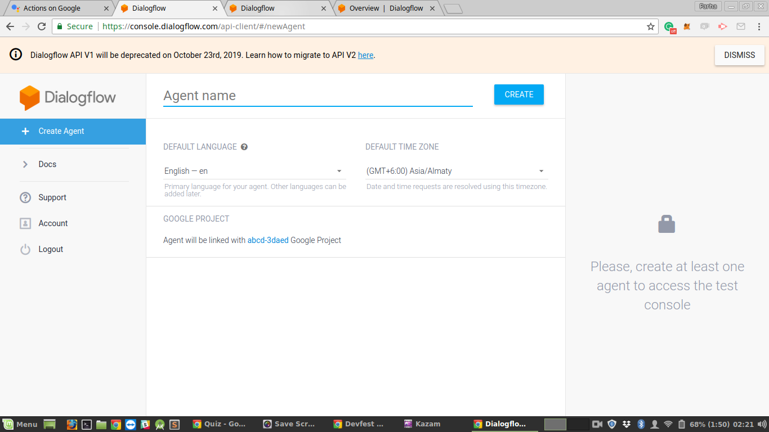
DialogFlow Agent Creation

Slide 11
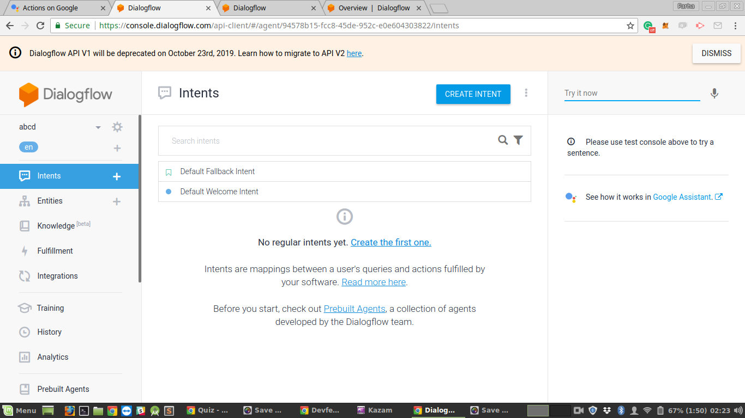

Slide 12
Intents:
the object that maps user utterances to your agent's response
Default Welcome Intent
Default Fallback Intent

Slide 13
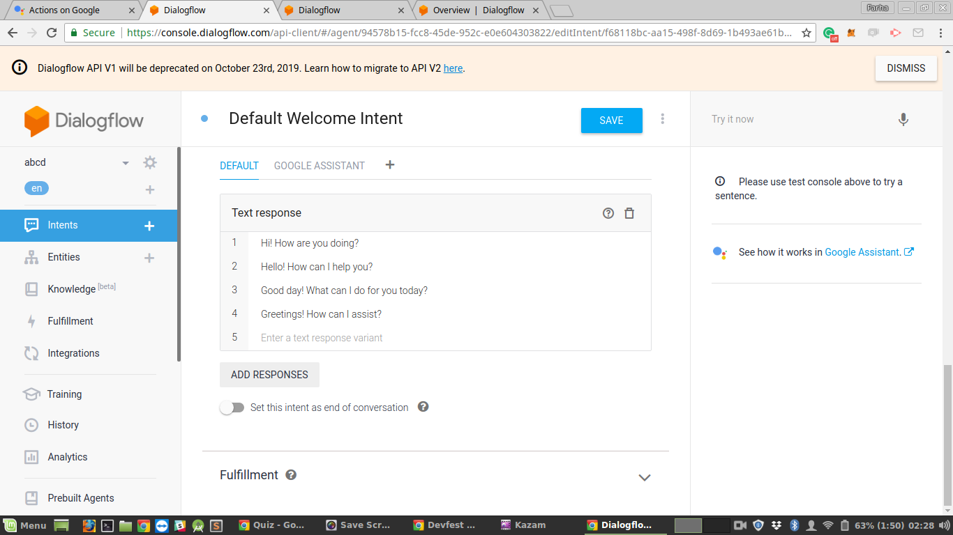
Your Assistant’s first response :)

Slide 14
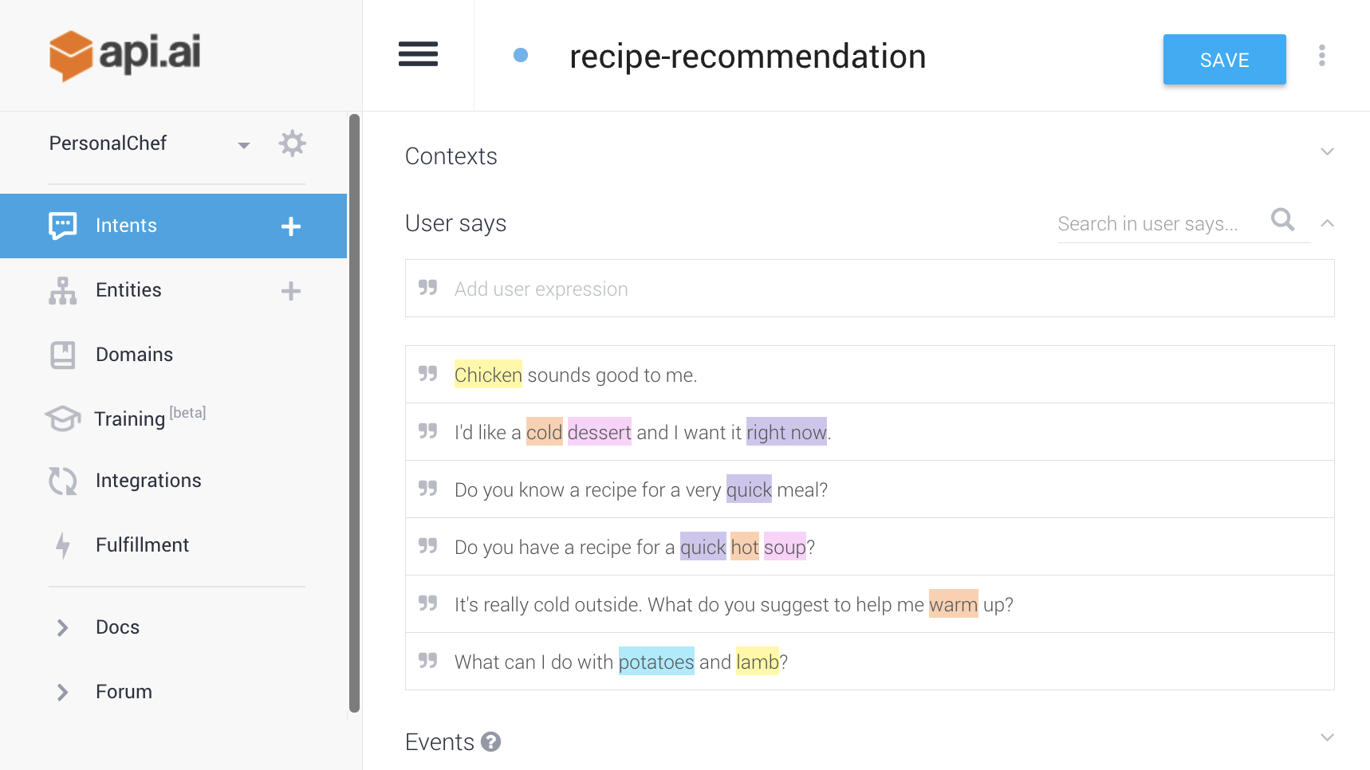
@
Entity Extraction — Identify key words and phrases spoken by the user.

Slide 15
RESPONSES
(Search for Action on Google Responses)
Default Response
Simple Responses
Basic card
Browsing Carousal
Suggestion Chip
Media Responses
Table card
List

Slide 16
FEEDBACK!
Google form.

Slide 17
THANK YOU

